Slide 1

Microsoft 365 platform community call
aka.ms/m365pnp
Your host in this call: Vesa Juvonen
June 21, 2022

Slide 2



Agenda
Latest updates and news on the Microsoft 365 platform
Group picture time with Together Mode!
Demos
Nik Charlebois - Using the Microsoft Graph PowerShell SDK for common operations
Alex Kwan - Get started with UI Library for Azure Communication Services

Slide 3
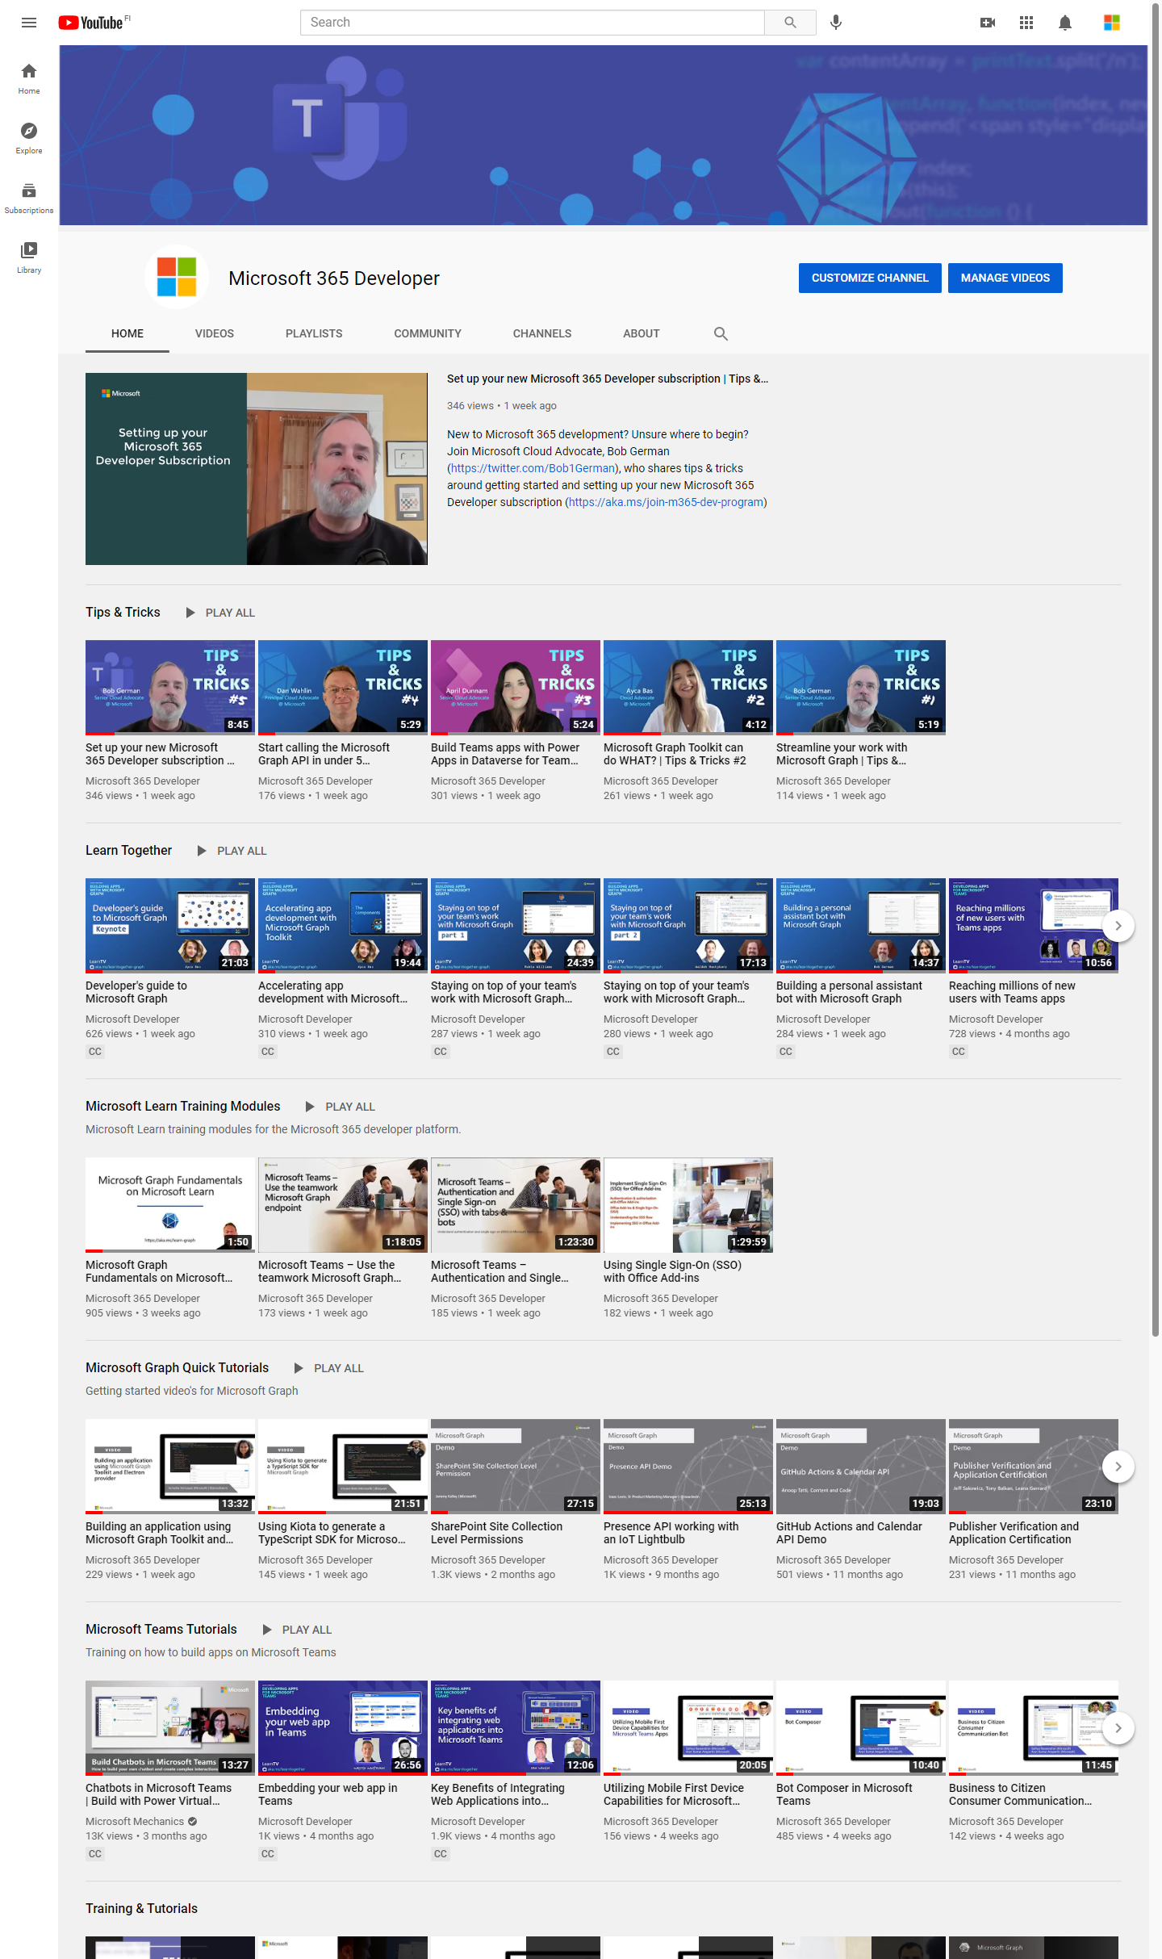
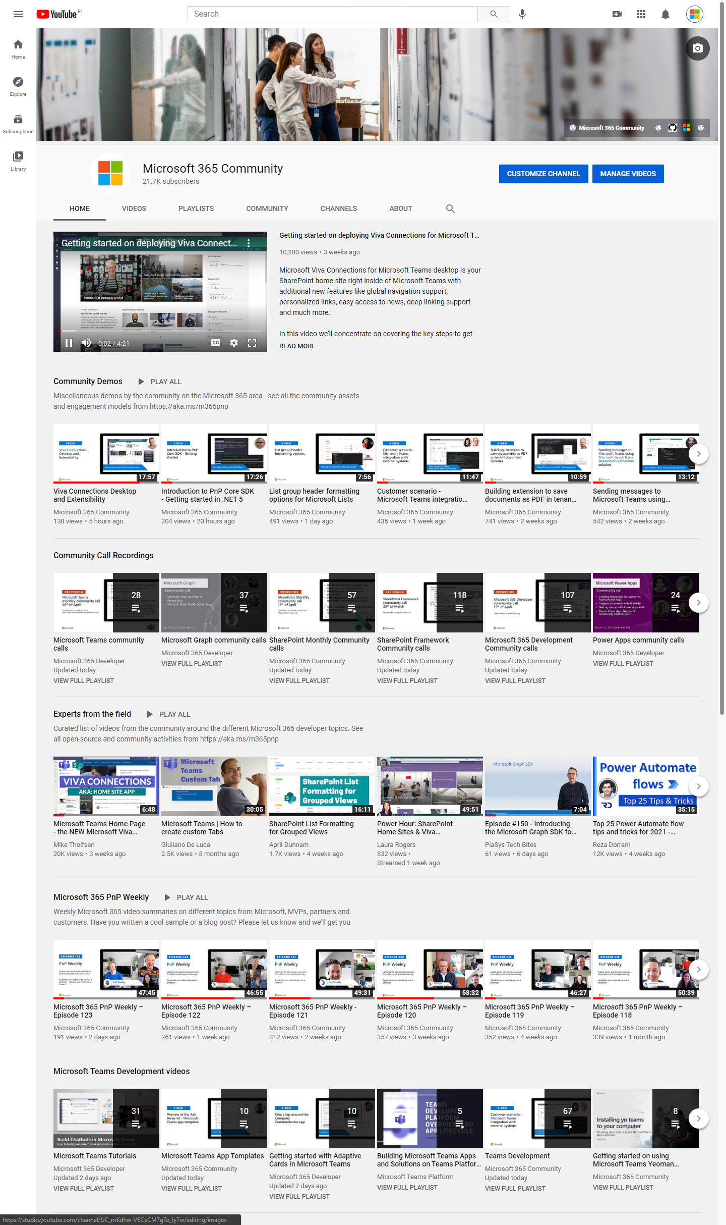
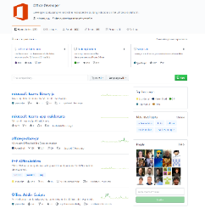
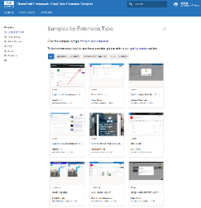
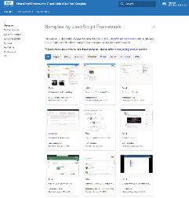
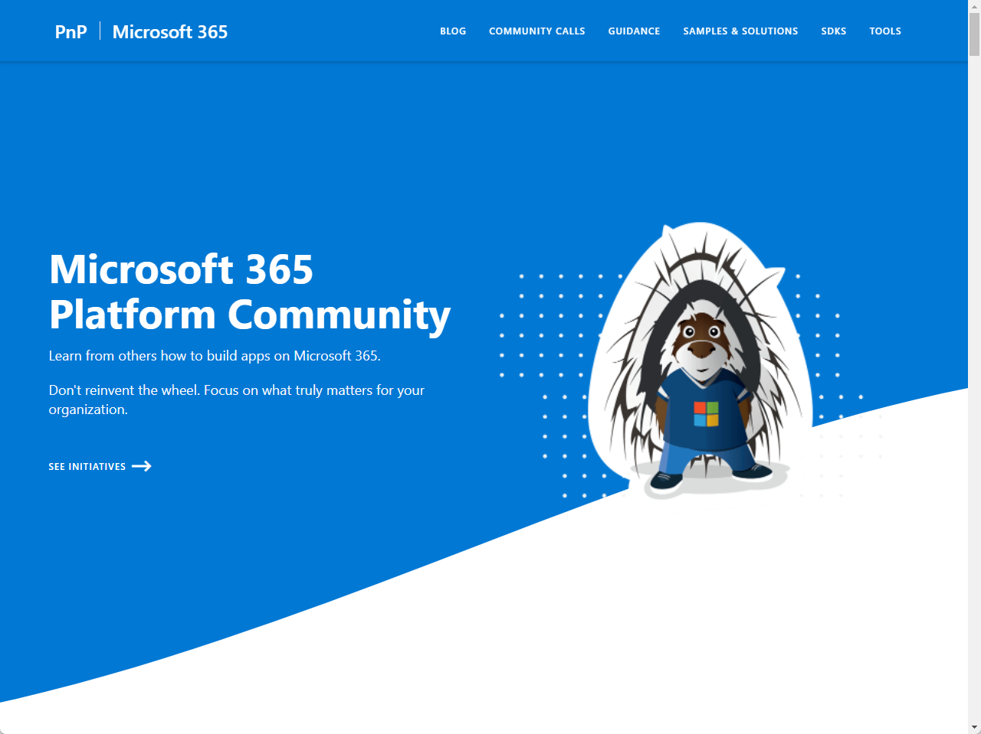
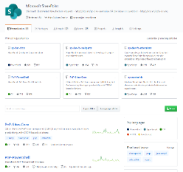
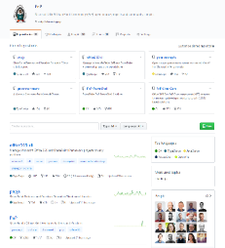
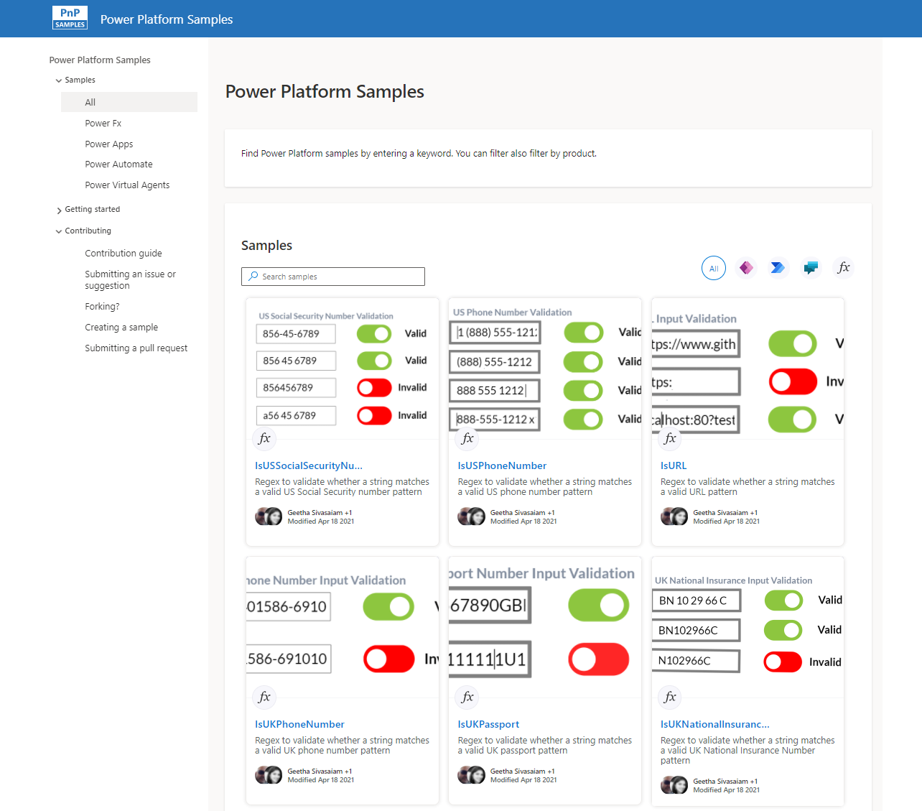
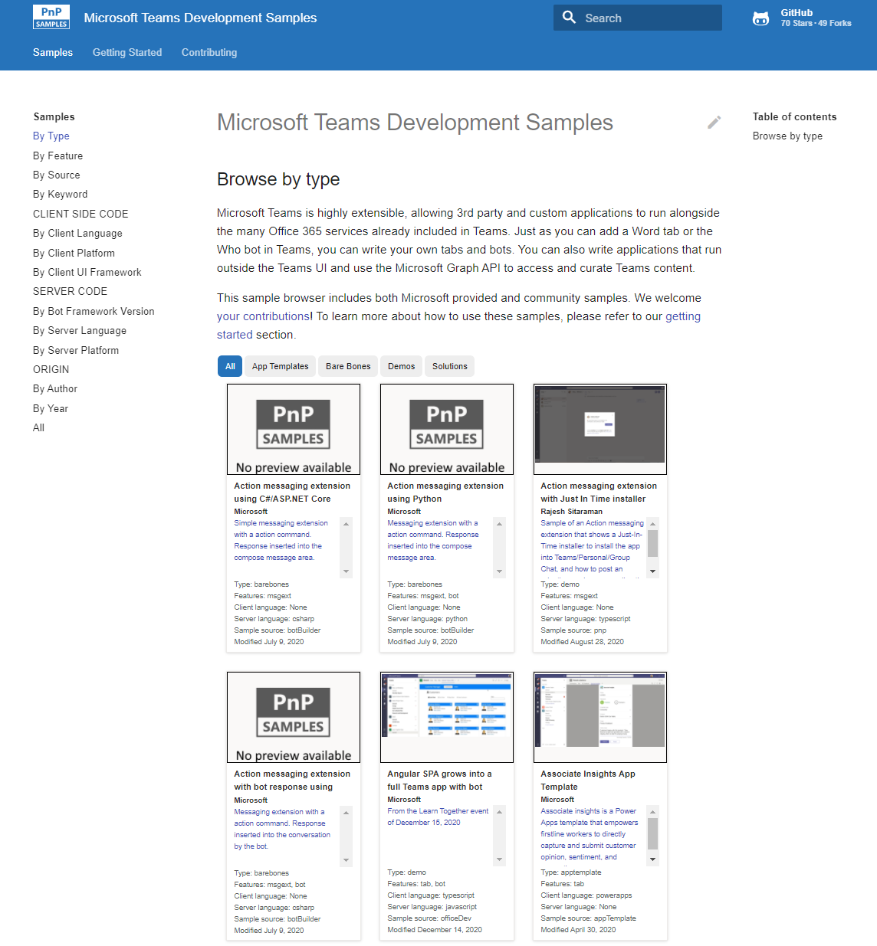
Microsoft 365 developer videos
Microsoft 365 community videos
Open-source
Sample galleries
Open-source initiatives and samples
aka.ms/m365devyoutube
aka.ms/m365/videos
github.com/pnp
github.com/officedev
github.com/sharepoint
github.com/microsoftgraph
aka.ms/m365/samples
aka.ms/teams-samples
aka.ms/spfx-webparts
aka.ms/powerplatform-samples
aka.ms/spfx-extensions
aka.ms/list-formatting
aka.ms/m365/community
@Microsoft365Dev | @m365pnp

Slide 4
Microsoft 365 developer community calls
Microsoft 365 platform (weekly) https://aka.ms/m365-dev-call
(Notice. This call is on a summer break between July 1st and 31st of August 2022)
Adaptive Cards https://aka.ms/adaptivecardscommunitycall
Microsoft identity platform https://aka.ms/IDDevCommunityCalendar
Office Add-ins https://aka.ms/officeaddinscommunitycall
Power Platform https://aka.ms/PowerAppsMonthlyCall
Microsoft 365 and Power Platform community (bi-weekly) https://aka.ms/m365-dev-sig
Viva Connections & SharePoint Framework (bi-weekly) https://aka.ms/spfx-call
Download recurrent invites from
https://aka.ms/m365/calls
Notes:
m365-dev-sig

Slide 5

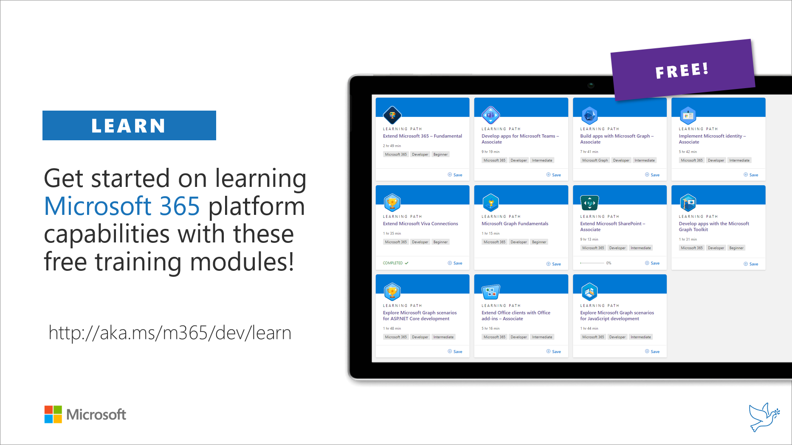
Getting started assets for Microsoft 365 dev
aka.ms/m365/devprogram
aka.ms/m365/dev/learn

Slide 6

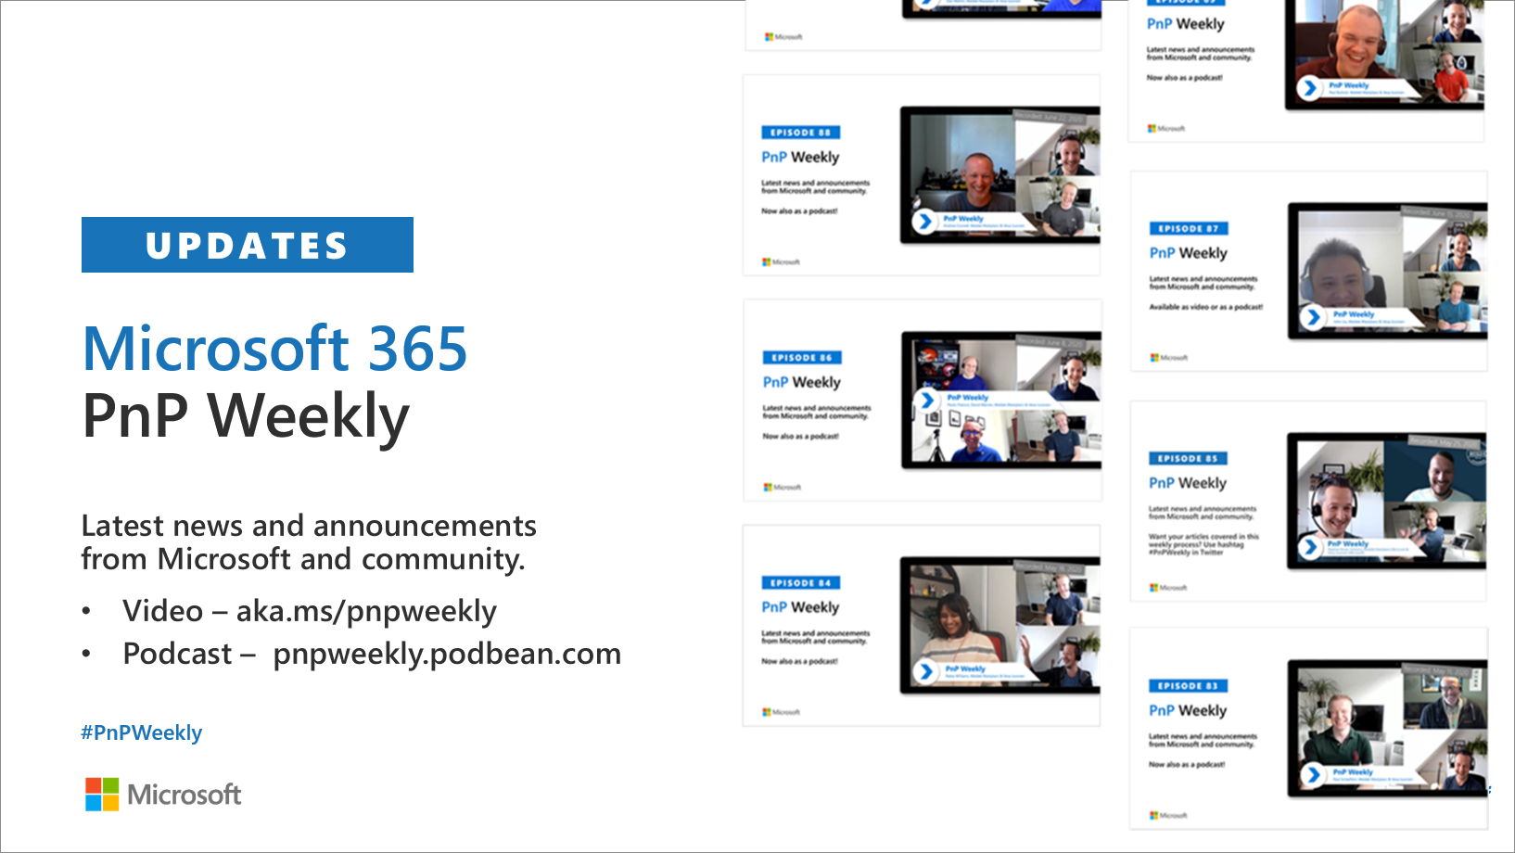
Microsoft 365 Developer podcasts
m365devpodcast.com
Video – aka.ms/pnpweekly
Podcast – pnpweekly.podbean.com

Slide 7

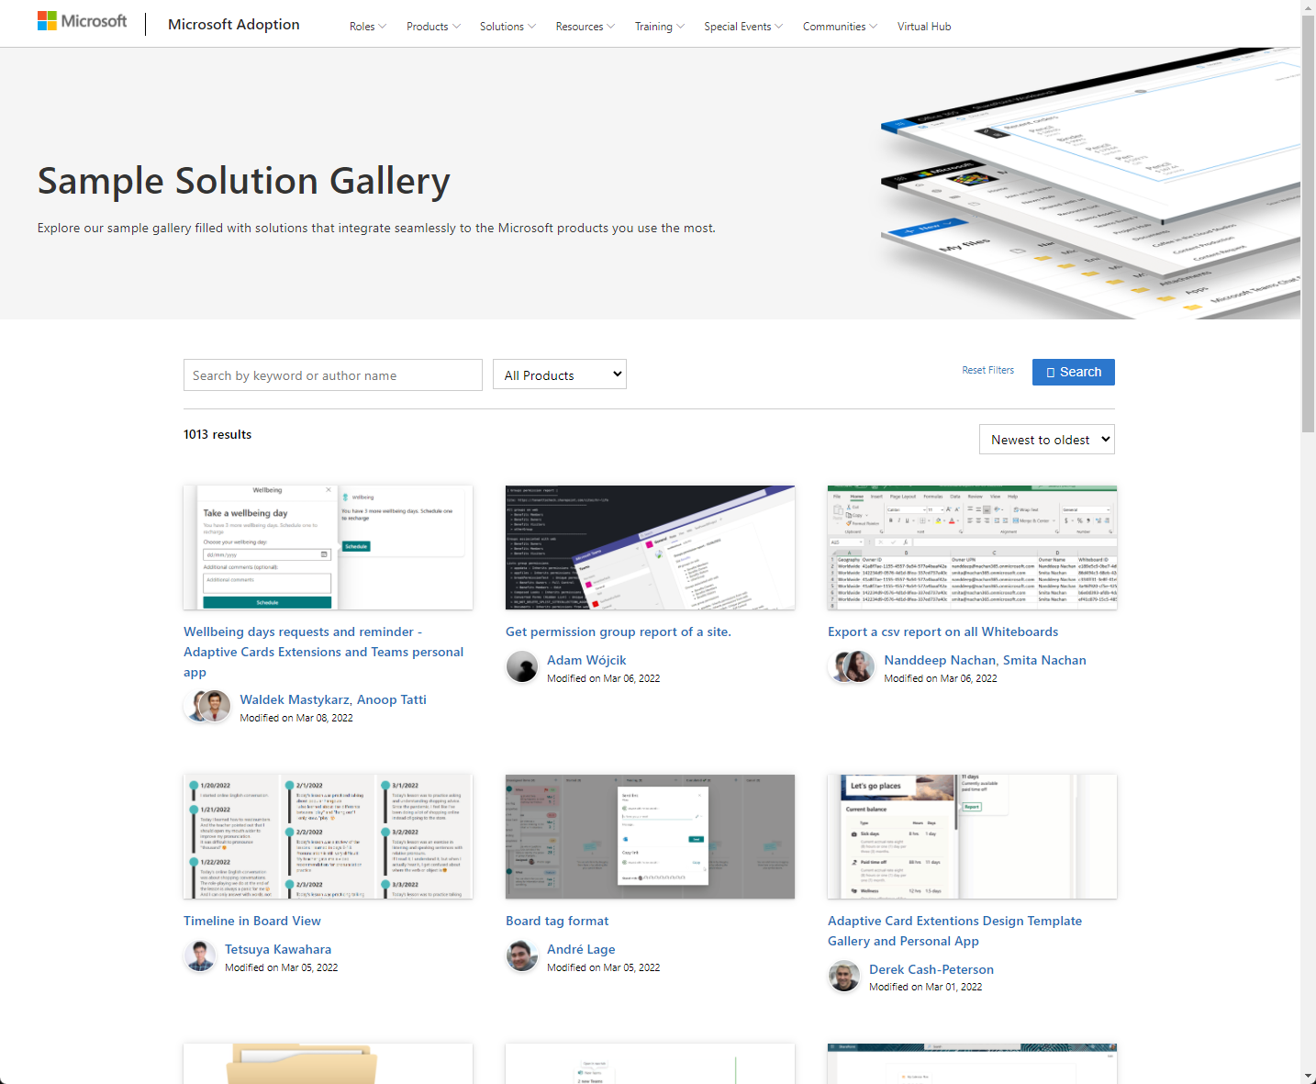
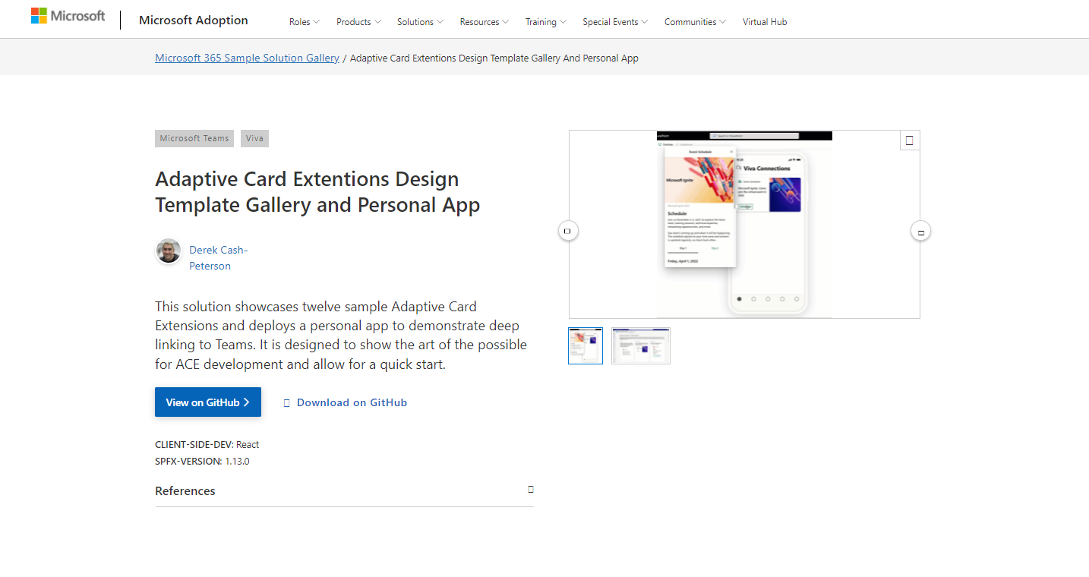
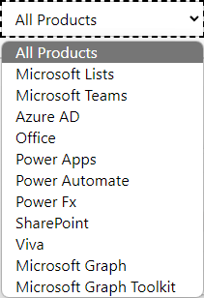

SAMPLES
New Microsoft 365 sample gallery with more than 500 samples from Microsoft and community
1100
aka.ms/m365/samples

Slide 8

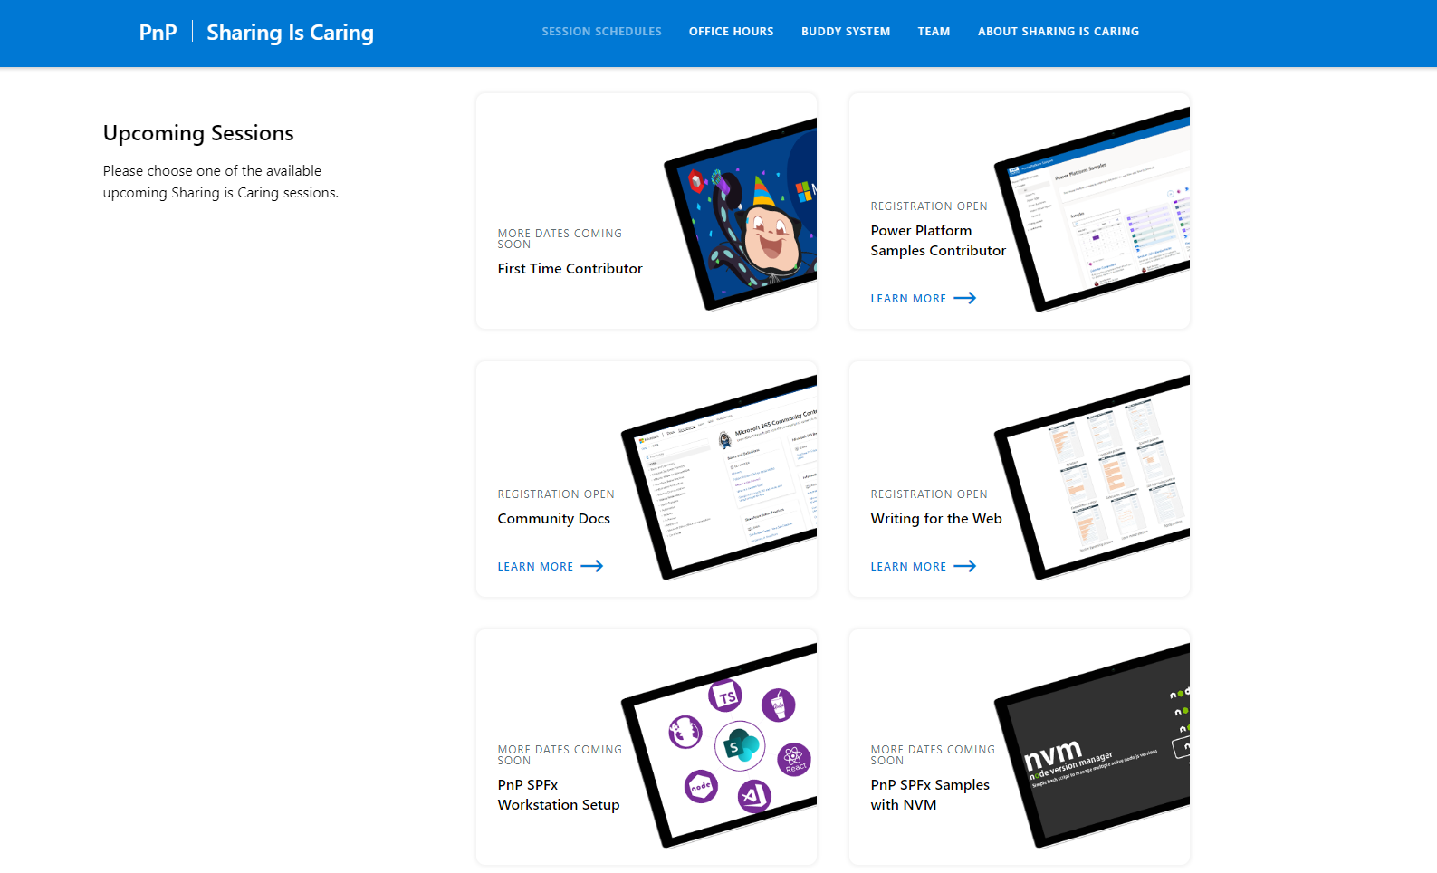
GUIDANCE
Learn how to get started in the open-source PnP community!
Upcoming Sessions:
General First Time Contributor
Power Platform Samples Contributor
SPFx Developer Workstation Setup
Using PnP SPFx samples w/ NVM
More than code with VS Code
First-time presenter
M365 Maturity Model Practitioners
Writing for the Web
Power Platform - Power Pages – Coming Soon!!!
THURSDAY!!
https://aka.ms/sharing-is-caring
Notes:
25 Total attendees, 16 attendees who attended both First-Time Contributors and Community Docs sessions.

Slide 9
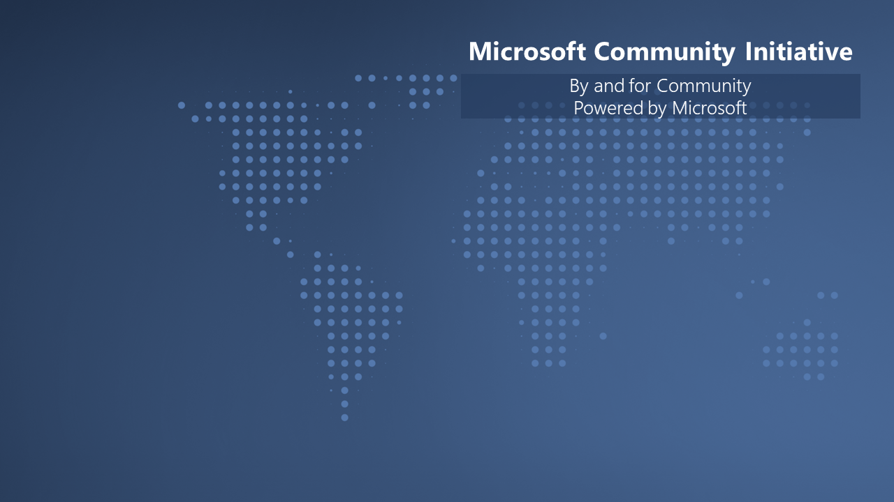

We are building unified Microsoft Cloud Community model with Microsoft 365 and Azure. We are looking for community members to the Community Advisory Board.
Submit at https://aka.ms/MCABLeaderApp

Slide 10

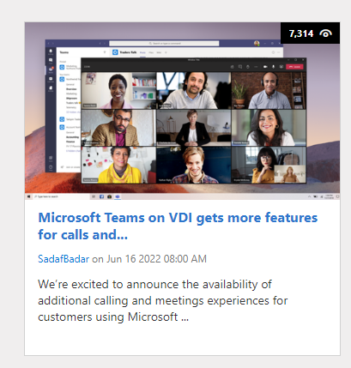
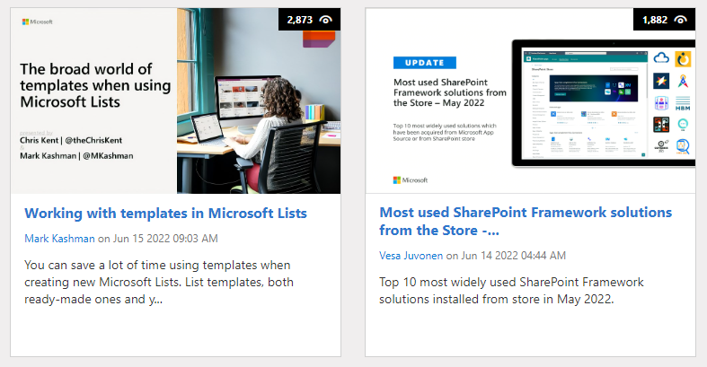
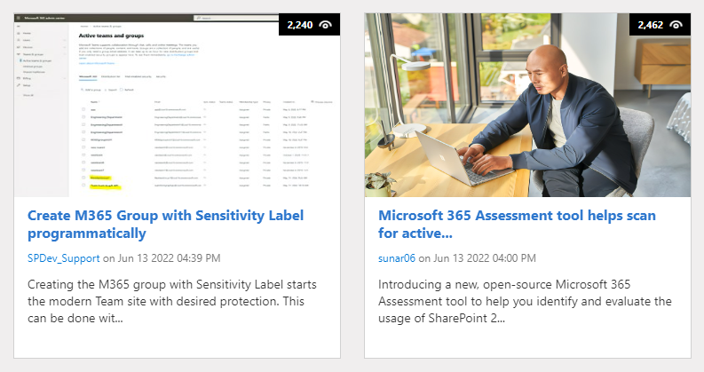
https://aka.ms/m365dev/blog
https://aka.ms/teams/blog
https://aka.ms/microsoftviva/blog
https://aka.ms/sp-blog
Notes:
We’re excited to announce the availability of additional calling and meetings experiences for customers using Microsoft Teams in a virtual desktop infrastructure (VDI) environment.

Slide 11
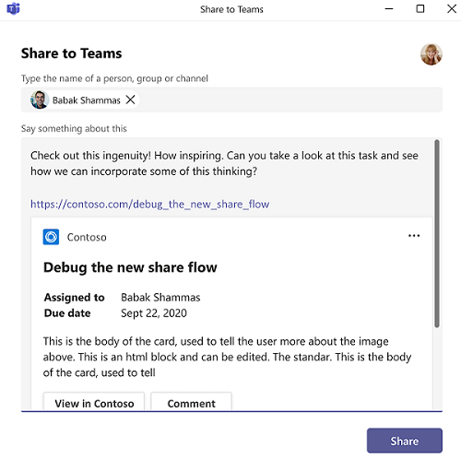
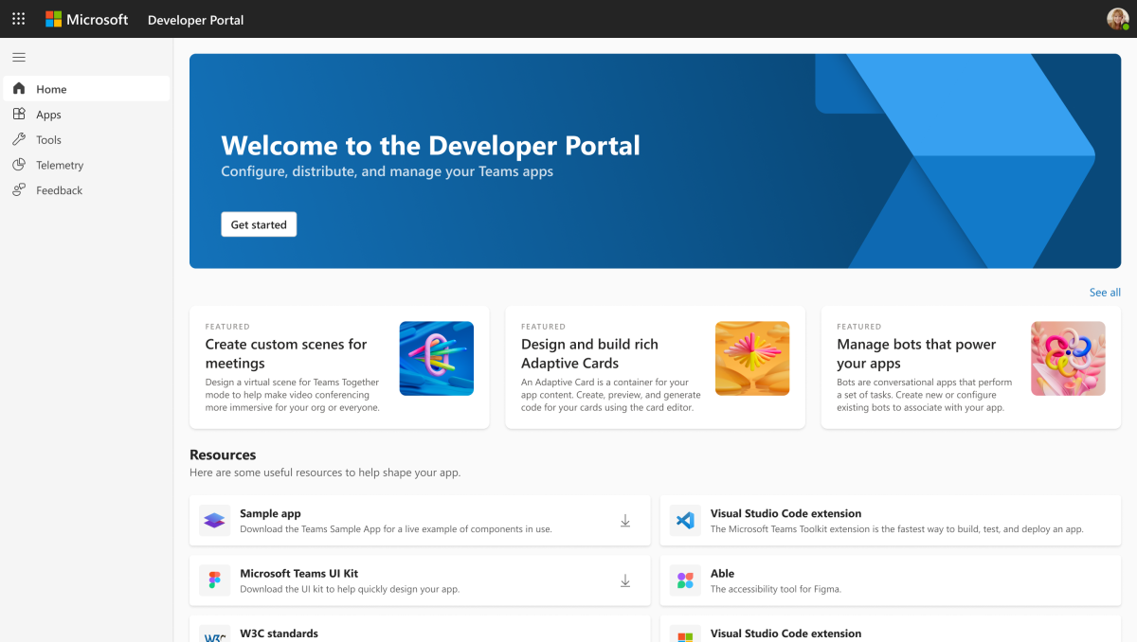






Teams Platform updates Feature update
1
Link unfurling support in Share To Teams (public developer preview)
2
App Studio will be deprecated by June 30, 2022.
Use Developer Portal: https://dev.teams.microsoft.com/
Docs: http://aka.ms/TeamsDevDocs > Tools and SDKs > Developer Portal for Teams
Docs: http://aka.ms/TeamsDevDocs > Integrate with Teams > Share to Teams
@Microsoft365Dev
aka.ms/TeamsPlatformUpdates
aka.ms/TeamsDevDocs
aka.ms/TeamsSamples
aka.ms/TeamsPlatformFeedback
Notes:
Wajeed covering 6/21/2022 Hello everyone. I’d walk you through the Teams platform updates. Let’s start with the platform update on the left side.
So the first update is on - Link unfurling support in Share To Teams dialog Using Share To Teams feature, third-party websites can use the launcher script to embed Share to Teams buttons on their webpages. When you select Share to Teams button, it launches the Share to Teams experience in a pop-up window. This allows you to share a link directly to any person or Microsoft Teams channel without switching the context.
Link unfurling allows your web service to "unfurl" the URL into a detailed card, providing more information than the standard website preview card. Till now Link Unfurling was supported only when you are composing a message. Now you can add link unfurling for the links shared through Share to Teams button hosted in web app, personal app or tab.
Note that this is still in Developer Preview.
2. Second update is on App Studio deprecation; This is repeat update from last week for the folks who are new here. it will be deprecated by 30 June. Now you can Configure, distribute, and manage your Teams apps with the new Developer Portal. Your existing apps will be available in Developer Portal under Apps/ App Studio. You can upgrade these apps to the latest configuration so that you can start using them in Developer Portal.
So, these were the platform updates, if you have any feedback or suggestion, please post on aka.ms/TeamsPlatformFeedback- the link is available in the footer. You could also follow us on twitter and configure to the RSS feeds to get regular platform updates.

Slide 12


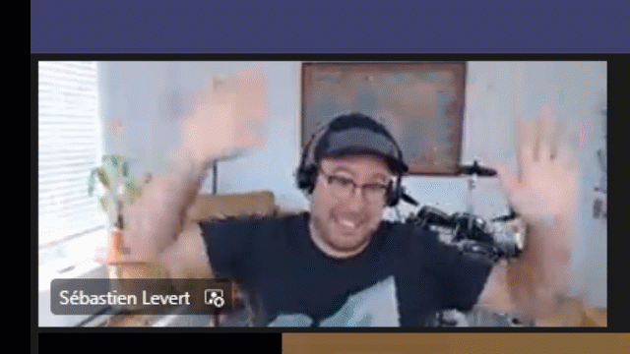
Optional picture time!
Video on and we’ll grab a Together Mode pic with those who are willing to do this.
We are together on this as a community!
Let’s all be like Seb
By enabling your camera for the picture, you grant us permission to share your picture in social media.

Slide 13

DEMO
Using the Microsoft Graph PowerShell SDK for common operations – Nik Charlebois
Get started with UI Library for Azure Communication Services – Alex Kwan

Slide 14
Thank you
Recording will be available in 24 hours on
Microsoft 365 Community (PnP) YouTube channel
https://aka.ms/M365PnP/videos
(subscribe today)
Follow us on Twitter
@Microsoft365Dev | @M365PnP
Next Microsoft 365 Platform call: June 28th at 08:00 am PT
All available community calls from https://aka.ms/m365/calls
(Notice. This call is on a summer break between July 1st and 31st of August 2022)

Slide 15
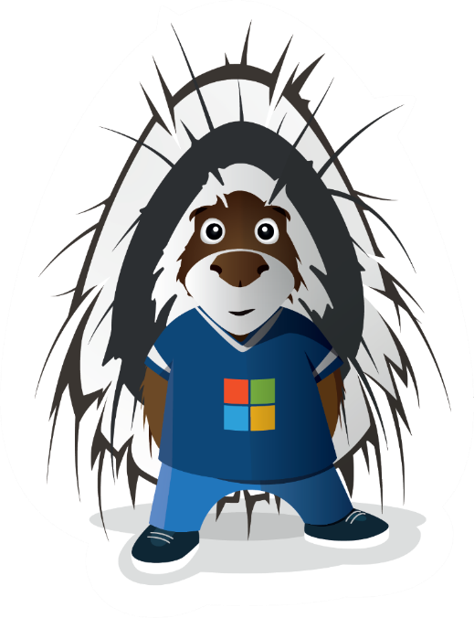


aka.ms/m365pnp

